Slide 1

SEIZURE DISORDERS DETECTION.

Slide 2
Membes:
Yogendra Naidu (21BTRCD028).
Amen Asfaw (21BTRCD058).
Chandon Kumar (21BTRCD057).
Prabal Dhar (21BTRCD056).
Veerendra.G (21BTRCD038).
Sajjad Ali (21BTRCD064 ).

Slide 3
Presentation agenda
01.
Introduction.
02.
Literature review.
03.
Problem statement.
04.
Proposed system.
05.
Architecture.
06.
Algorithm.

Slide 4
Introduction
Seizure prediction plays a crucial role in managing epilepsy, and ML models offer a groundbreaking solution. These models analyze data, identify patterns, and predict seizures with remarkable accuracy, enabling timely intervention and personalized treatment. Join us as we explore the transformative potential of ML in revolutionizing the lives of individuals affected by epilepsy. Together, let's envision a future where innovation and compassion converge to shape the landscape of healthcare. Welcome to the realm of seizure detection using ML.

Slide 5
Literature review

Slide 6
Title | authors | Review | Limitations | Accuracy
"Seizure Detection Using Long Short-Term Memory (LSTM) Model" | G. K. Babu, and M. C. Rajan | This paper presents a novel LSTM (Long Short-Term Memory) model designed for detecting epileptic seizures in EEG (Electroencephalogram) signals .The LSTM model achieves an impressive accuracy rate of 98.5%, surpassing existing methods and demonstrating its superiority in terms of accuracy, sensitivity, and specificity. |  | 98.5%
Application of Machine Learning To Epileptic Seizure Detection | Ali Shoeb and John Guttag | The paper presents a SVM-based method for detecting epileptic seizures using scalp EEG signals. The approach utilizes patient-specific classifiers and has the potential for clinical application, with plans for further research on integrating it into a closed loop control system for a vagus nerve stimulator. | The study relies on a relatively small dataset, which limits the generalizability of the findings. | 96%
Seizure detection using SUPPORT VECTOR MACHINES(SVM) | Tulasi Pendyala, Anisa Fathima Mohammad & Anitha Arumalla. | In the experiments, KNN achieved high accuracy and sensitivity without feature selection, but lower accuracies were obtained when using feature selection. SVM outperformed KNN with the highest accuracy and sensitivity when feature selection was applied. | -High dimensionality of the feature space. -Dependency on the choice of kernel function and its parameters. -Degrade SVM performance.
Application of Epileptic Seizure Detection Using Machine Learning Classifiers. | Nasir Hussain and Muhammad Khubeb Siddiqui. | This paper presents a thorough evaluation of machine learning classifiers in epileptic seizure detection, offering insights into their advantages, limitations, and clinical applicability. It serves as a valuable resource for researchers, clinicians, and developers to enhance the accuracy and efficacy of seizure detection systems, benefiting individuals with epilepsy. | Availability of annotated datasets. -Interpretablity of machine learning models. -Generalizability and scalability issues.
Epileptic Seizure Detection Using Machine Learning: Taxonomy, Opportunities, and Challenges. | Muhammad Shoaib Farooq | This systematic literature review focused on epileptic seizure detection methods. It analyzed papers using ML classifiers and wavelet-based feature extraction, highlighting datasets and recommending future research on predictive models and a dedicated dataset for seizures in children.

Slide 7
Problem statement .
Seizure prediction is a complex task in epilepsy research, requiring careful data preprocessing. Challenges include handling noisy and unstructured data, extracting relevant features, addressing imbalanced datasets, capturing temporal dynamics, and standardizing the data. Preprocessing techniques must remove noise, select informative features, balance the dataset, model temporal relationships, and standardize the data. By addressing these challenges, researchers can improve the accuracy and reliability of seizure prediction models, leading to enhanced patient care and safety for individuals with epilepsy.

Slide 8
Proposed system .
The task is to create a machine learning solution capable of accurately and in real-time detecting and predicting seizure disorders in individuals by analyzing diverse data sources, including EEG recordings, clinical information, and potentially other relevant data modalities.
Key challenges to address:
Data preprocessing : Obtaining diverse and labeled EEG data from individuals with seizure disorders, along with clinical information, poses challenges in terms of data collection, privacy, and security.
Feature Extraction: Feature extraction from EEG recordings and other data modalities is a critical and challenging task for training ML models, as it involves identifying meaningful patterns, temporal relationships, and discriminative features within large and complex datasets.
Classification and Prediction: Developing an ML model for real-time seizure classification and prediction, distinguishing normal brain activity, pre-seizure states, and seizure events, enabling timely intervention and preventive measures.
Generalization and Adaptability: The ML model should be flexible and robust enough to handle variations, different seizure types, and accommodate new data sources, ensuring its practical implementation in diverse scenarios.
Real-Time Performance: The ML model must provide fast and accurate results in real-time, prioritizing low-latency for timely seizure detection and intervention.

Slide 9
Architecture.
Data Preprocessing:
The main key factors for data preprocessing in seizure prediction using LSTM can be summarized as follows:
Data Quality, Segmentation Length, Feature Selection, Feature Normalization, Data Balancing, and Train-Test Split are key factors. Data quality ensures clean EEG data, while appropriate segmentation captures temporal patterns. Feature selection extracts informative features, normalized to comparable scales. Balancing addresses class imbalance. Train-test split evaluates model performance. These factors collectively contribute to accurate seizure prediction using LSTM.

Slide 10
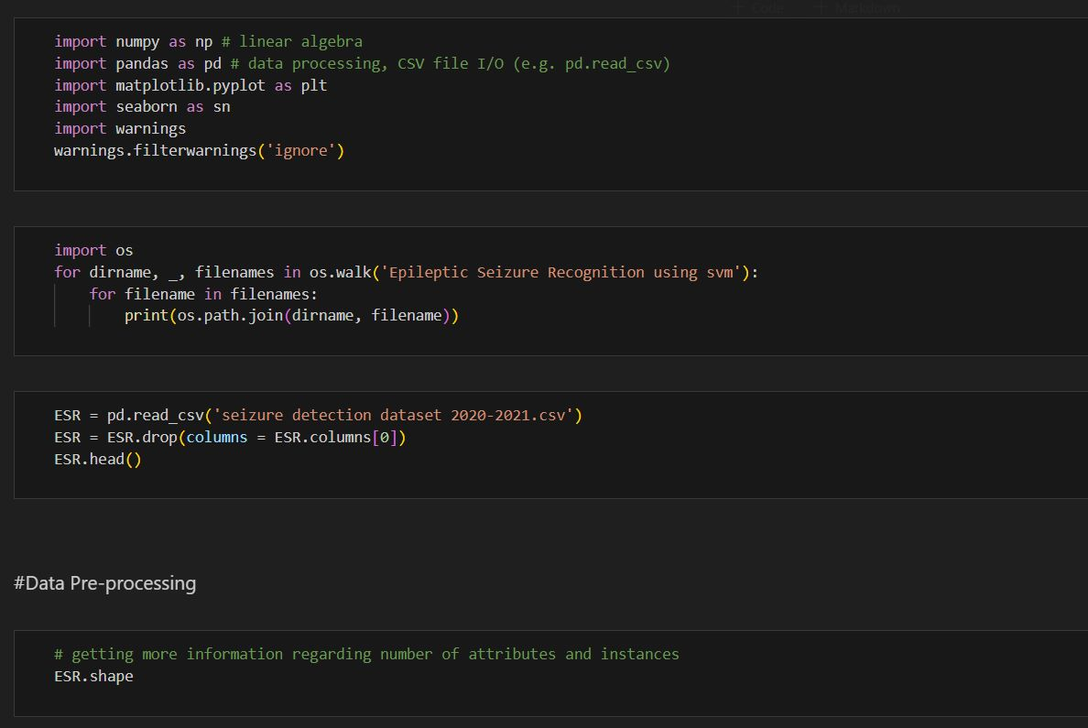
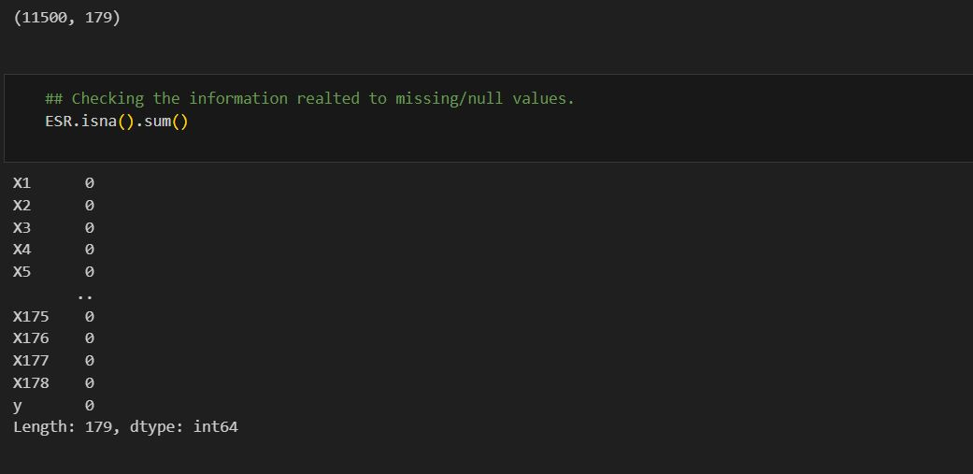
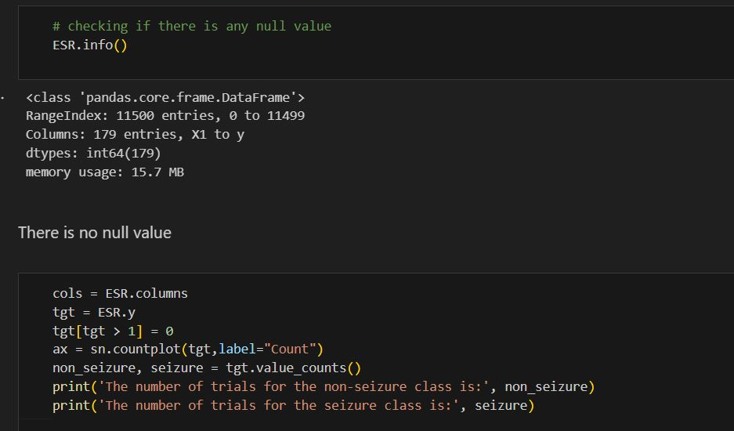
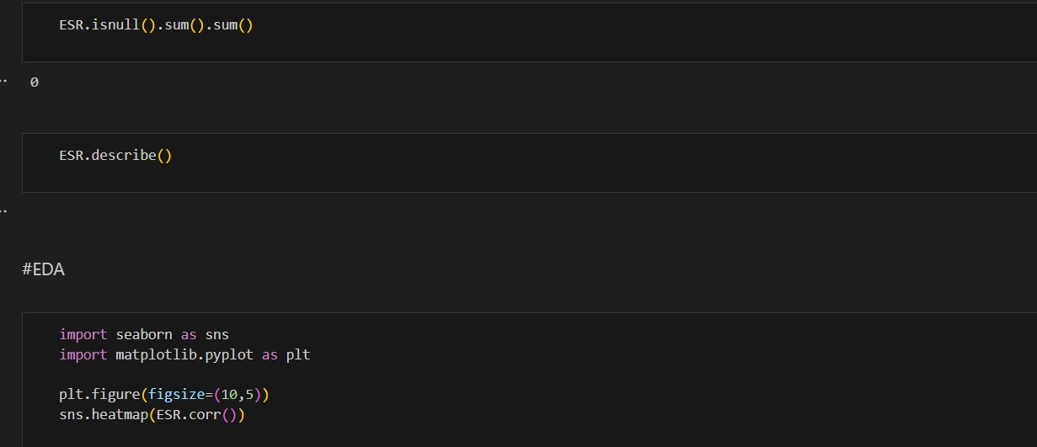
Algorithm.

Slide 11
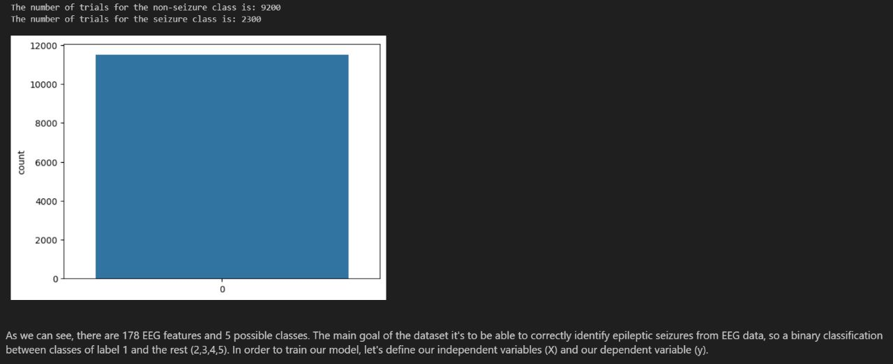
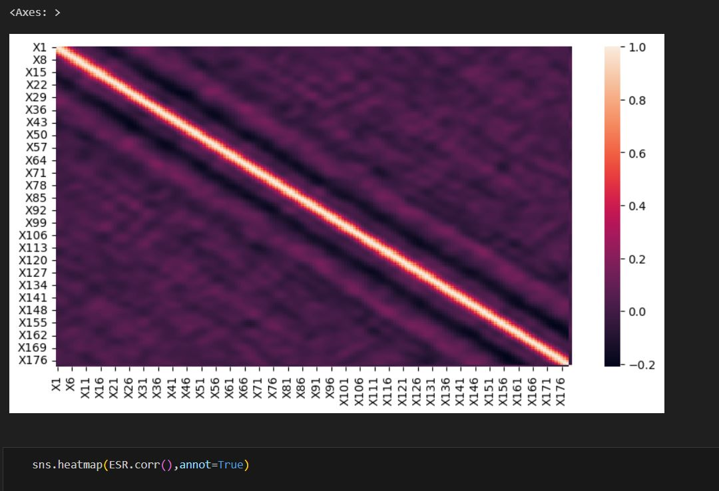
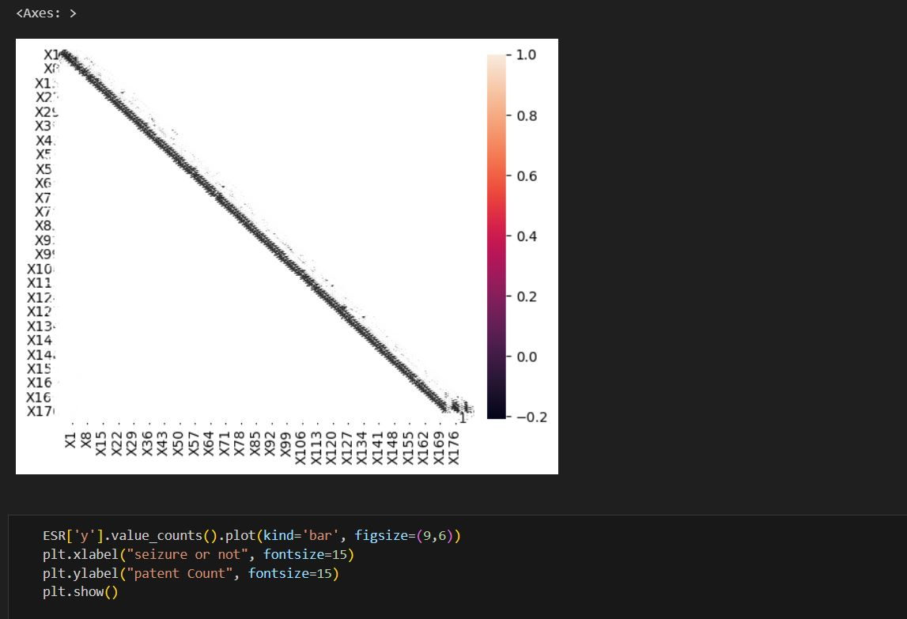
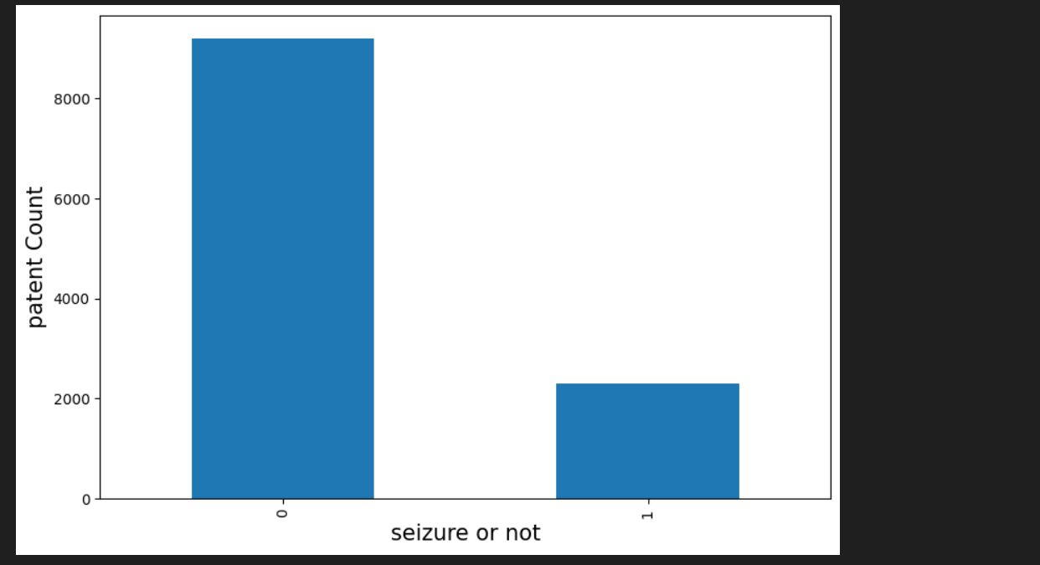

Slide 12
References
G.K. Babu and M.C.Rajan (2022). Seizure Detection Using Long Short-Term Memory (LSTM) Model
Ali Shoeb and John Guttag (2010). Application of Machine Learning To Epileptic Seizure Detection
Tulasi Pendyala, Anisa Fathima Mohammad & Anitha Arumalla. (2022). Seizure detection using SUPPORT VECTOR MACHINES(SVM)
Nasir Hussain and Muhammad Khubeb Siddiqui. (2022). Application of Epileptic Seizure Detection Using Machine Learning Classifiers.
Muhammad Shoaib Farooq (2023). Epileptic Seizure Detection Using Machine Learning: Taxonomy, Opportunities, and Challenges.

Slide 13
Resources
https://ieeexplore.ieee.org/stamp/stamp.jsp?arnumber=9740802.
https://icml.cc/Conferences/2010/papers/493.pdf.
https://braininformatics.springeropen.com/articles/10.1186/s40708-020-00105-1.
https://link.springer.com/chapter/10.1007/978-981-16-9650-3_22#author-information.
https://www.mdpi.com/2075-4418/13/6/1058.
https://www.frontiersin.org/articles/10.3389/fnins.2020.578126/full.

Slide 14
Thanks!

